Slide 1

When Culture Meets Innovation
BYU Creativity, Innovation,
and Design Group
March 22, 2021

Slide 2
Culture and innovation
Main point: innovators need to be attuned to users’ cultural beliefs when generating novel products and services
  (Of course, culture is just one of many things to consider)
What is culture? shared meanings constituted by beliefs, values, symbols, language, hierarchies that are learned and transmitted by a group of people

Slide 3
Culture and innovation
But first, I want to make the case that cultural beliefs impact the adoption of products (and consumption more generally)

Slide 4
Cultural Beliefs Influence Product Adoption
(and consumption)
Clothes (suit v. tank top)
Restaurants (KFC v. Log Haven)
Cooking (Kraft Mac & Cheese v. prime rib)
Cars (pickup truck v. Tesla)
Sporting goods (yachting equipment v. hunting gear)
Consumer goods
  Chromebook v. Mac Pro
  Casio v. Bulova
Music (Drake v. Vivaldi)
Theater (Les Mis) v. movie theater (Avengers)

Slide 5
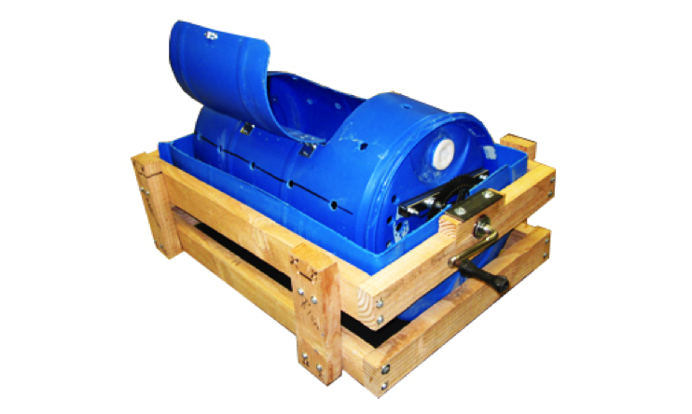
Cultural Beliefs about Gender Influence adoption
Human-powered washing machine designed for Uros Islands, Puno, Peru (versus washing on rocks in lake water)
  35-gallon drum inside 55-gallon barrel
  Smaller drum is perforated with opening for clothes
  Water is put in larger drum
  Smaller drum rotates to agitate clothes
    Using bicycle crank

Slide 6
Cultural Beliefs about Gender Influence adoption
Advantages of washing machine
  Parts obtained locally
  Keeps user dry, warm
  Cleans clothes well
  Saves time
However, women found it difficult to rotate, required a lot of force; inadequately wrung out clothes
  Local gender beliefs about whom should wash clothes impacted success

Slide 7
Cultural Beliefs about Water Influence adoption
Water boiling campaign (Rogers 2005)
  Small village (Los Molinas) in Peru, 1950s
  Goal: prevent spread of infectious disease
  Two-year effort by public health agency
Effective for 11 out of 200 families in village
  Low adoption rate due to cultural beliefs
    Custom: only the sick used cooked, hot water
    Taste: villagers learned to dislike boiled water from early age (otherwise use flavoring such as sugar, cinnamon, lemon, herbs)

Slide 8
Beliefs about Transportation Influence adoption
Gasoline Powered Automobiles in early 1900s
Success Was Not Foregone Conclusion
  Competing types of engines: electric, steam, gasoline
  Competing terminology: velocipede, motocycle, locomobile, electric runabout, electric buggy, horseless carriage, quadricycle

Slide 9
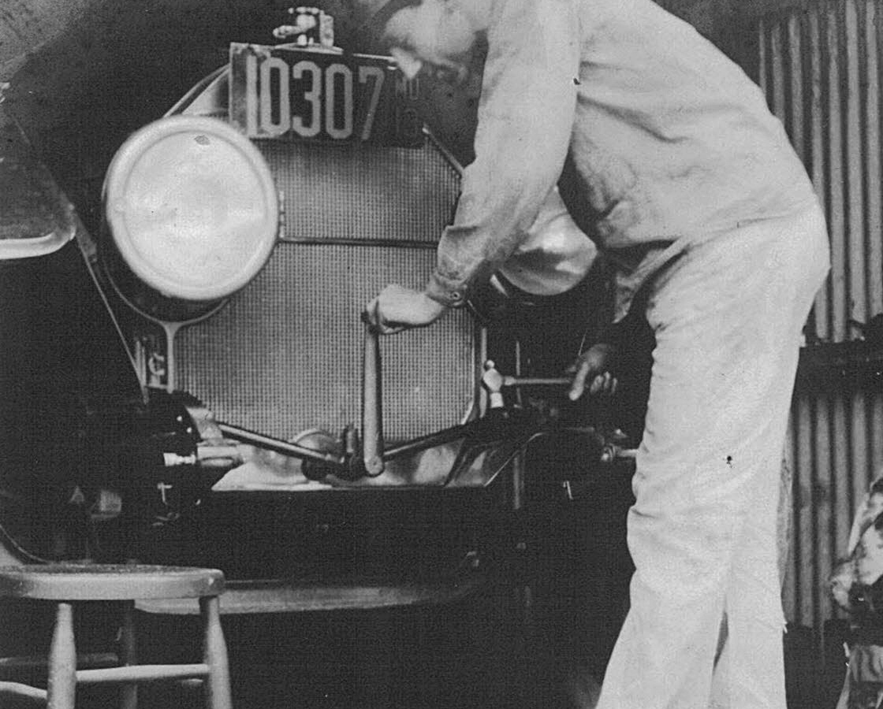
Beliefs about Transportation Influence adoption
Internal combustion → dangerous
  Bicycle importer, Albert Pope from Boston: “You can’t get people to sit on an explosion!”
  Not uncommon to break bones when turning hand crank to start car

Slide 10
Cars → disturbed community life
(Rao 2009, pp. 24-25)

Slide 11
Cars → unreliable (for good reason)
Times-Herald Race (Thanksgiving Day, 1895)
  Chicago to Evanston (54-mile course)
  Six entrants: 4 gas, 2 electric, only 2 finished
    Winner finished in 7 hours, 53 minutes, averaged 7 mph

Slide 12
But Automobile Clubs Organized Contests
Contests emphasized dependability, durability (Rao 2002)
  Included hill-climbing, fuel economy, endurance
Contests…
  “Made the car comprehensible”
  “Told a plausible [cultural] story about the reliability and safety of the car”
  Changed cultural beliefs about appropriateness of car (Rao 2009)

Slide 13
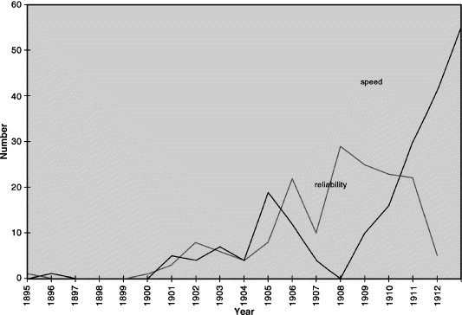
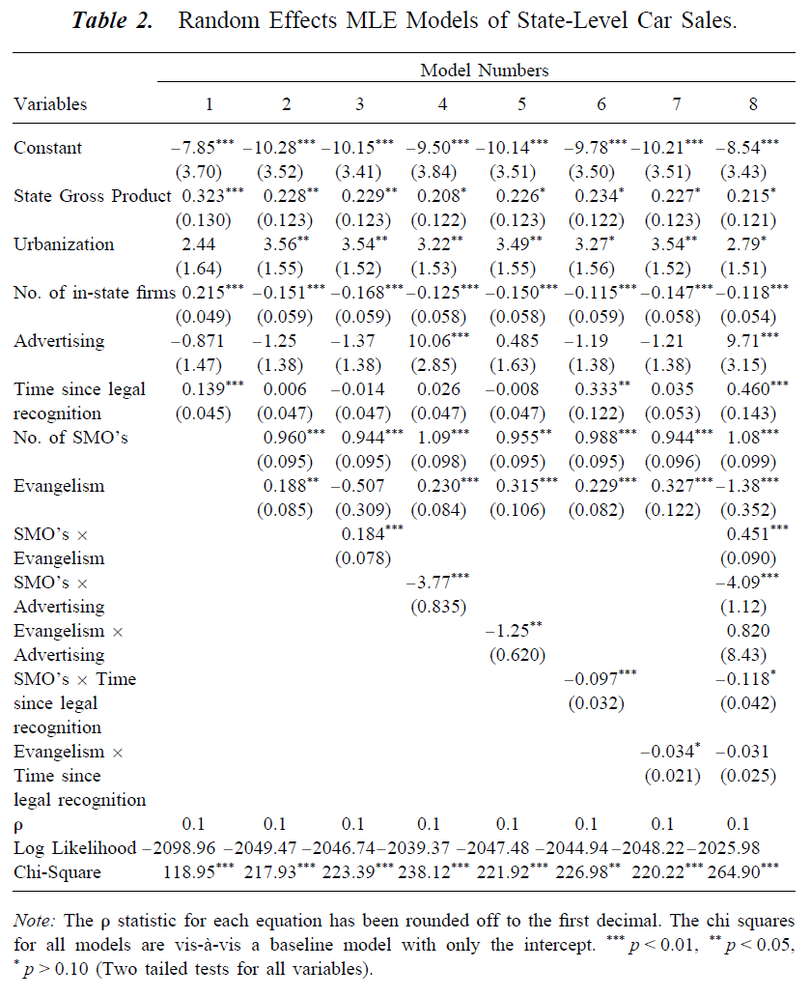
Regression models predicting state
car sales, 1895-1912 (Rao 2002)
1913
(auto clubs)
(reliability contests)
Rao, Hayagreeva. "Institutional activism in the early American automobile industry." Journal of Business Venturing 19.3 (2004): 359-384.
Henry Ford’s assembly line

Slide 14
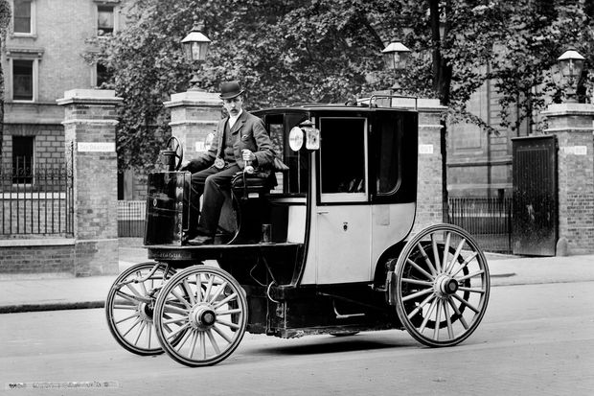
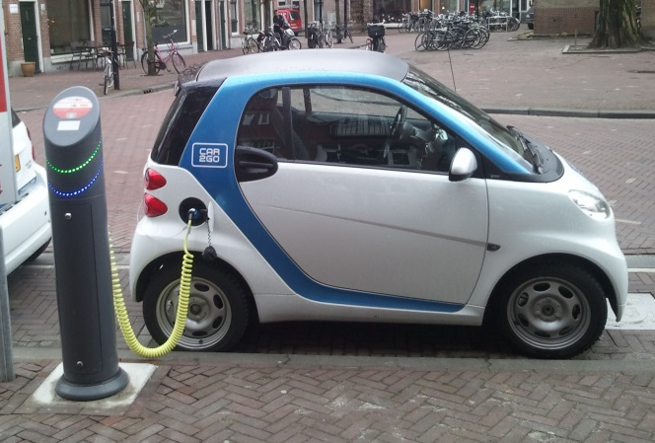
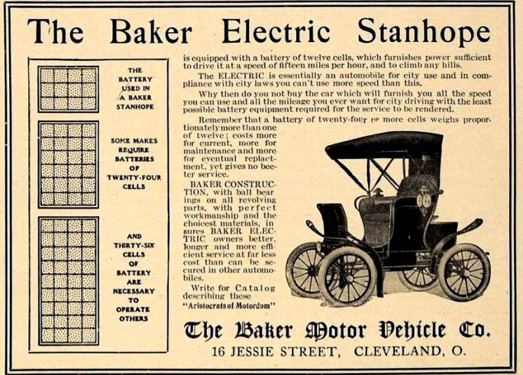
Similar Lessons Apply to Electric Vehicles
Unsuccessful in 1900
Successful (acceptable at least) in 2021
Electric cab, London, bet. 1897-1900
How did the electric car become culturally accepted?
PHOTO: ENGLISH HERITAGE/HERITAGE IMAGES/GETTY IMAGES
http://www.brightsideofnews.com/news/2012/6/28/1900s-electric-car-battery-gets-2012-update.aspx

Slide 15
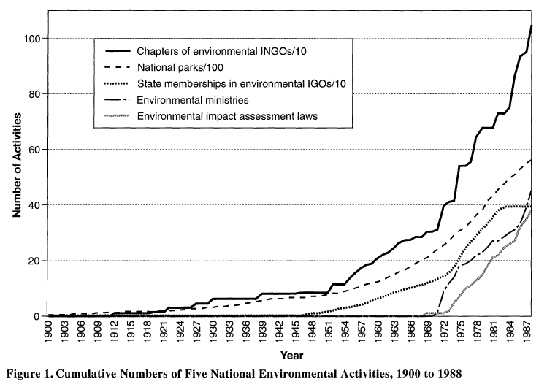
Environmental Protection Became A Cultural Issue
Legitimation of Environmental Protections in Pictures
Frank et al. 2000

Slide 16
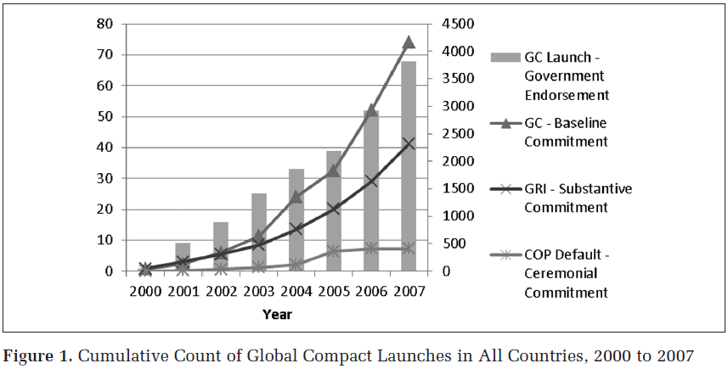
Environmental Protection Became A Cultural Issue
UN Global Compact
Voluntary initiative wherein corporations pledge commitment to human/labor rights and environmental protection practices
Global Reporting Initiative
NGO that certifies firms that voluntarily disclose their economic, environmental, and social activities
Lim & Tsutsui 2012

Slide 17
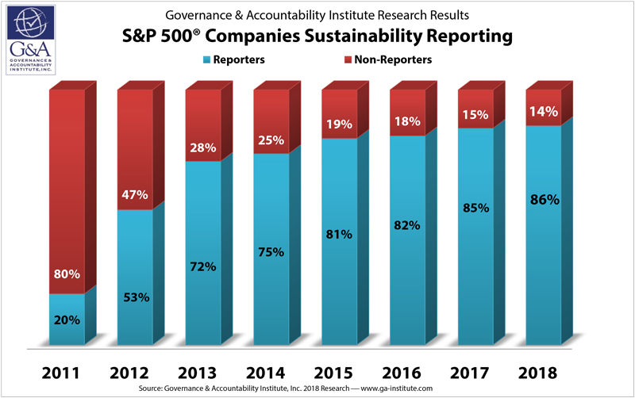
Environmental Protection Became A Cultural Issue
https://www.3blmedia.com/News/Flash-Report-86-SP-500-Indexr-Companies-Publish-Sustainability-Responsibility-Reports-2018

Slide 18
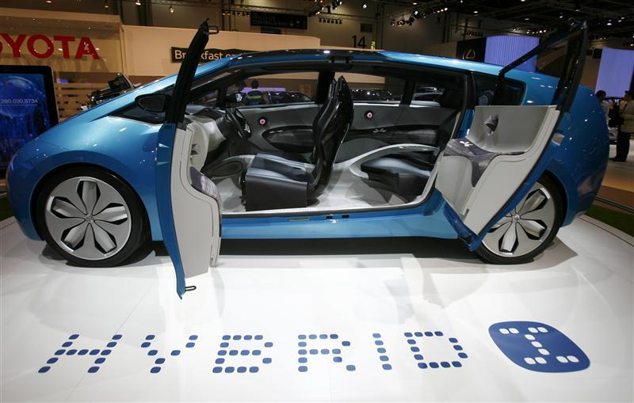

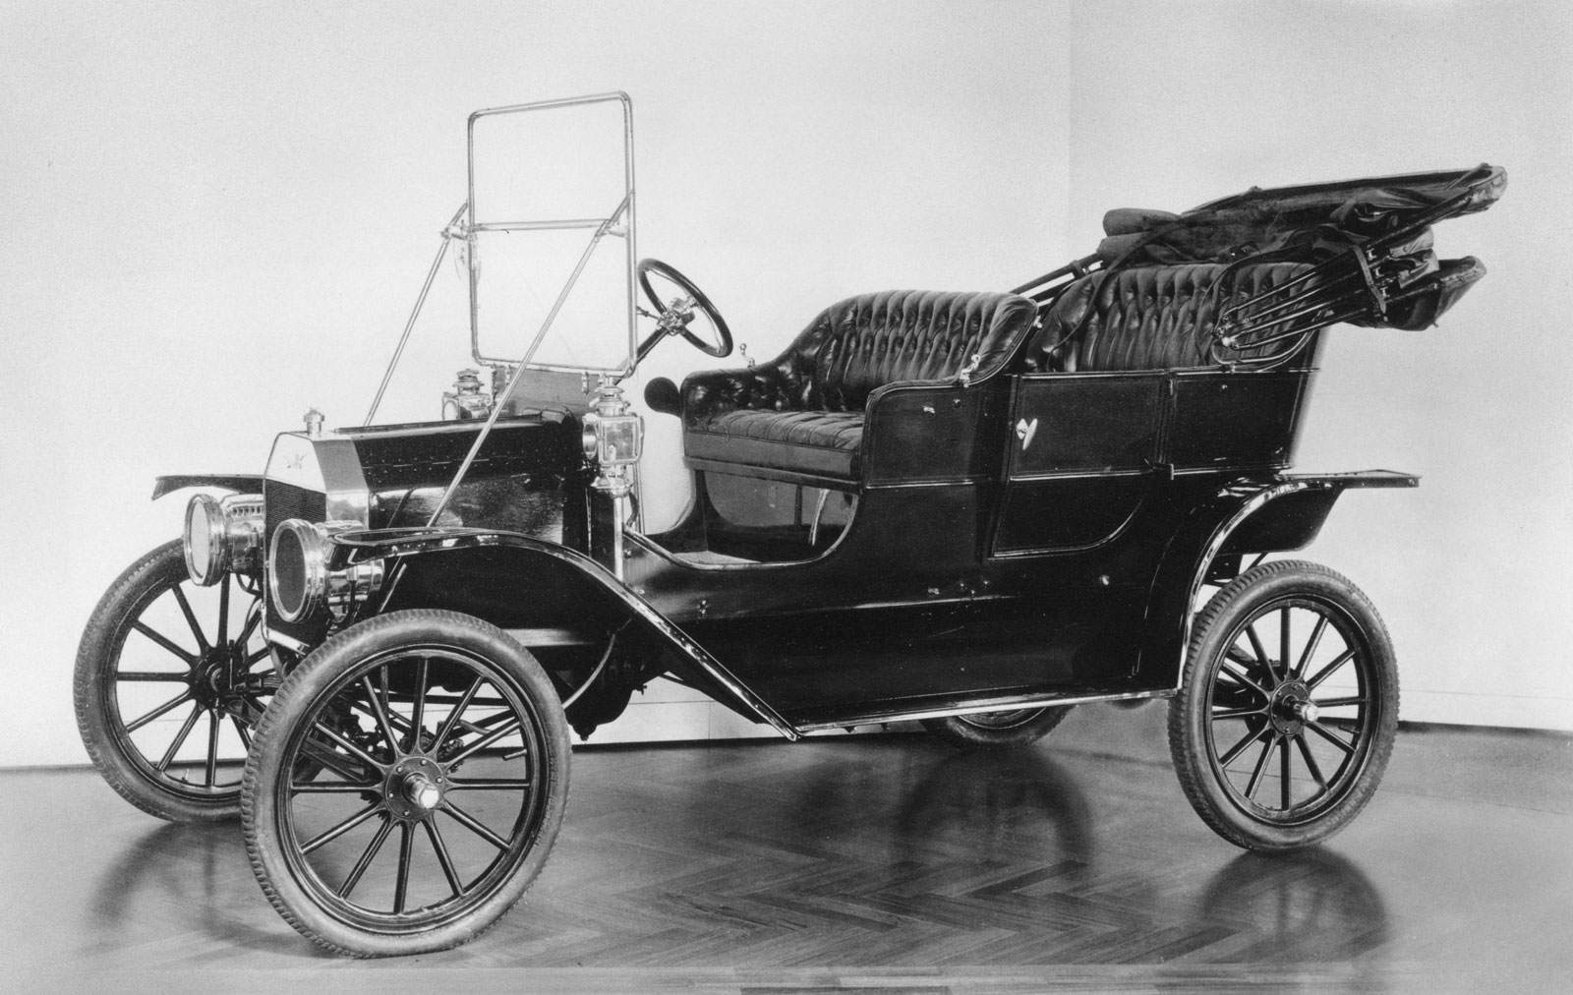
From 1900 to 2020
Acceptable in 2015
Unsuccessful in 1910
Current/future success
Successful in 1915

Slide 19
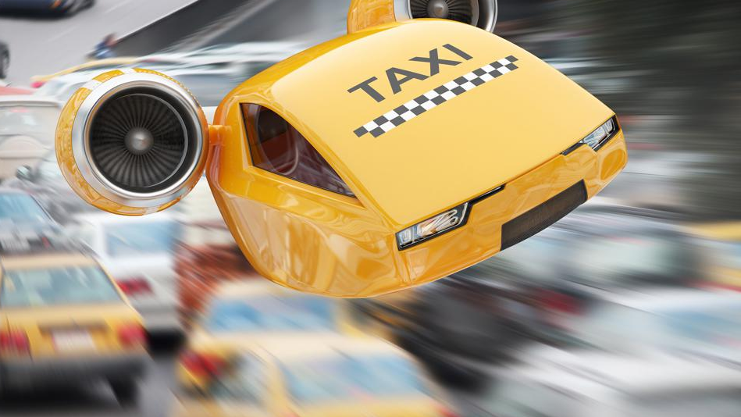
What’s next? flying cars?
https://www.wsj.com/articles/what-came-before-the-9-billion-bet-on-flying-taxis-11615566244
https://www.forbes.com/sites/bernardmarr/2020/06/29/introducing-the-mindboggling-flying-taxis-of-the-future/?sh=4b01864218dd

Slide 20
Culture and Design
If culture is constituted by shared values, beliefs, language, communication, and practices…
  How does culture matter for innovation? How should we innovate to gain cultural acceptance? (keep in mind that cultural beliefs help potential users make sense of products)

Slide 21
Lessons for innovators
“Make [it] comprehensible”, “tell a plausible story”
Lesson 1: stories from everyday people
Lesson 2: build on existing products and beliefs when designing new products
Lesson 3: allow users to create the products

Slide 22
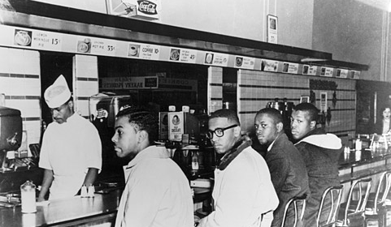
Lesson 1: Identify with others
February 1, 1960 (Greensboro, North Carolina)
Sit-in movement
  When a Midwestern college student saw images of the sit-ins he said “we were joltingly awakened to the fact that we must do our part as thinking African Americans, and take a
  definite stand in the fight for equal rights” (Polletta 1998:147)

Slide 23
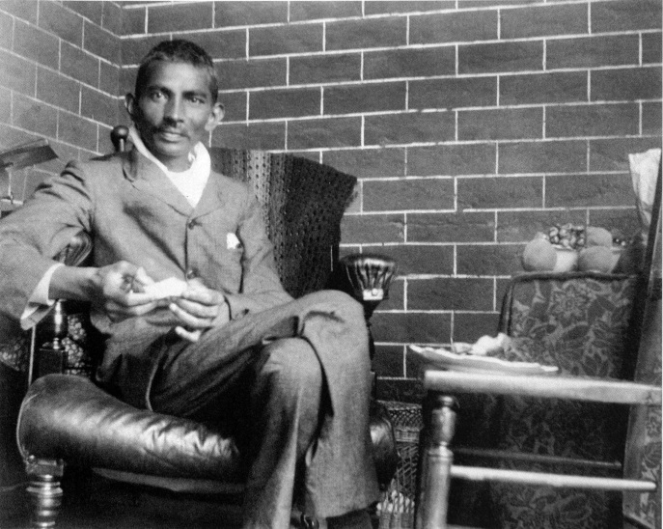
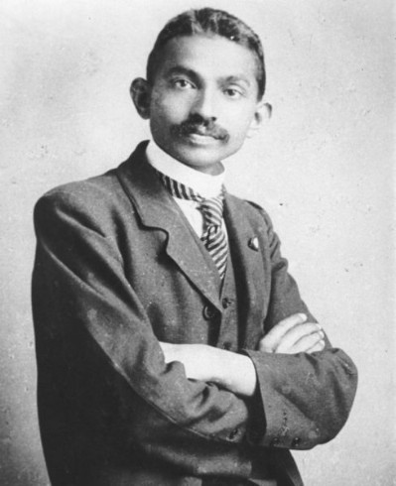
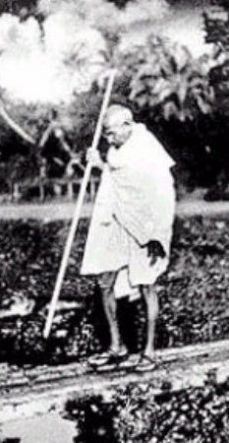
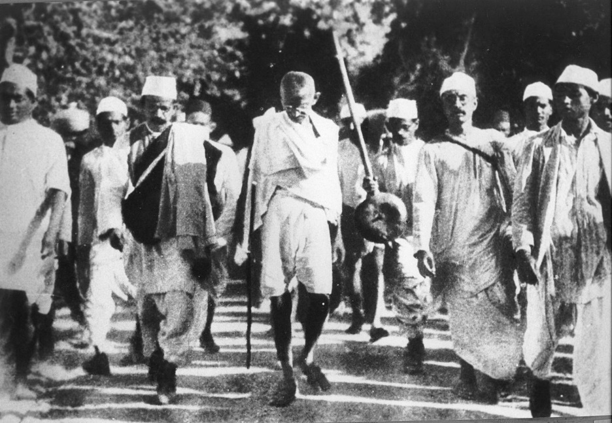
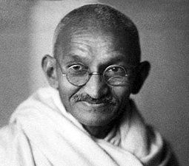
Identify with Others
Gandhi studied law in London & practiced in South Africa for 21 years before leading India’s fight for independence. Compare earlier pictures of Ghandi with these…

Slide 24

Lesson 1: use Micro Influencers
Social media users with 1k to 100k followers (including industry experts or topic specialists) who post favorable mentions of products,
Example: Banana Republic worked with micro-influencers who modeled its clothing in a variety of settings.

Slide 25


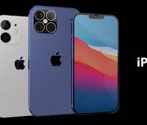
Lesson 2: Build on Existing Products or Beliefs
Link new product/feature to existing products
  iPhone: voicemail + texting + phone + mobile internet
  DVR: DVD + streaming technology
  MP3 player: Sony Walkman + MP3 files
  Hybrid car: gas car + beliefs about environment
What’s the “story?” You know how this works. This is how it fits into your life. Just like other, similar products.

Slide 26

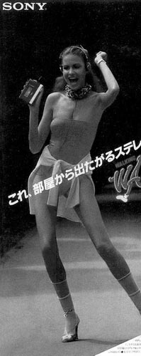
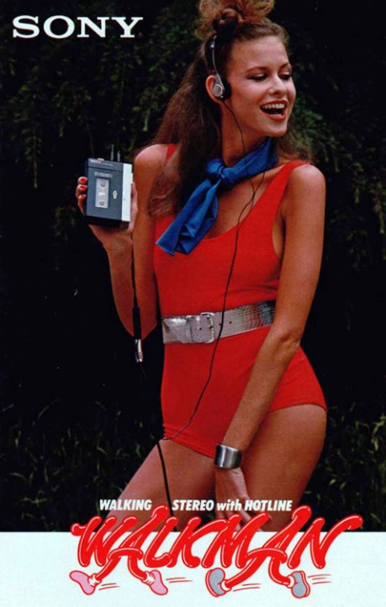


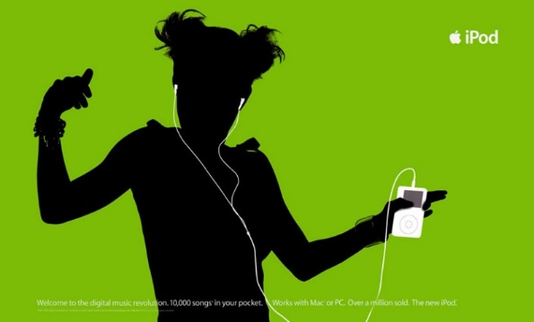
From Walkman to iPod
Ads from 2004-2008
Ads from the early 1980s
(Japan)

Slide 27
Design Practice (Human-centered design)
Incorporate local cultural beliefs, practices in products/features
  (you already do this)
Learn about local community, users; feedback from users
  Visit, observe local communities
  Use technology mediated communication: phone, email, blogs, IM, FB

Slide 28
Lesson 3: Allow Users to Create the Products
Move beyond human-centered design
  (Learn about users, present prototype, solicit feedback)
  Great option, but can introduce bias thru order of presentation, etc.
Give potential users, local engineers, other practitioners autonomy to design, manufacture, market, distribute
  Admittedly, this is a radical approach (I have not done this)

Slide 29
The Productive Method
“participants to work together to create a cultural object, some thing that did not exist” (McDonnell and Vercel 2019: 325)
Ask (multiple) groups to make a product that solves a problem
      (Ensure group composition varies—e.g., by race, class, gender, age—to represent potential users)

Slide 30
The Productive Method
Requires participants to work together to create a product
    Reveals participants’ shared cultural beliefs (v. personal beliefs)
      Participants must articulate beliefs, explain them to coordinate task
      Reveals conscious and unconscious cognitive processes, shared beliefs
    First, group brainstorm (using nominal group technique or Method 635/brainwriting)
    Then, group deliberates about product & how to represent it

Slide 31
Example: Aids Campaign in Ghana
McDonnell (2014, 2019) asked groups to make a poster with message about AIDS that their community needs to hear
    He provided materials: paper, colored pencils
    Sample
      7 groups: 5 HIV-negative, 2 HIV-positive
        Mixed-gendered, varied by social class background

Slide 32
The Productive Method
Observe and document interactions
      What to observe?
        Expressions of “acceptance, disgust, frustration, and excitement by nod­ding or shaking heads, raising voices, sitting forward in seats-all externalized, observ­able indicators of emotional states, coherence, or disagreement that do not require participants to have reflexive metacognitive self-observation. Emotional highs and lows can be incredibly revealing, suggesting when the group is motivated to act or frustrated by their inability to find a cognitive fit. Timing also matters-people may come to agree­ment quickly or slowly through reflection and deliberation” (McDonnell and Vercel 2019, p. 328)

Slide 33
Example: Aids Campaign in Ghana
Revealed automatic cognitive processing
  “one group came to quick consensus that they should draw a skeleton, suggesting that this image was ready at hand. The association of AIDS and skeletons was offered without hesitation-suggesting it resulted from automatic, practical consciousness (DiMaggio 1997; Vaisey 2009). The rest of the group accepted this without reflection or criticism, suggesting this symbolic link was taken for granted” (McDonnell and Vercel 2019, p. 330)

Slide 34
The Productive Method
Compare the process with the product
      How was the ultimate object was selected, translated, and arranged? “Which schemas did the group embody in that object? How did they represent it? How do these ideas interact? The ultimate rep­resentation of these schemas can reveal unconscious associations that are not typically verbalized. Comparing the product to the process that created it can reveal a great deal about which schemas are widely shared or taken for granted, and which are contested” (McDonnell and Vercel 2019, p. 328)

Slide 35
Example: Aids Campaign in Ghana
Revealed deliberative cognitive processing
“Another group faced the prob­lem of how to represent the effects of the disease while acknowledging its invisibility and avoiding [the] stigma [of living with HIV]…. The creative solution that emerged out of this deliberation was to use the color red to depict HIV-positive stick figures and green to depict HIV-negative. [These colors allowed them to represent someone as healthy and asymptomatic, but infected, while also communicating the danger and warning that using a fear-based skeleton approach would permit.] The solution of using red (which Ghanaians strongly associate with HIV) clearly resonated, as the group expressed heightened emotions and excitement-raising voices and sitting up in their seats-and thus motivated the group to collaborate on how they could use red in their poster to solve this problem” (McDonnell and Vercel 2019, p. 330; see also McDonnell 2014, p. 264)

Slide 36
Comparing across Groups Revealed How Widespread Cultural Beliefs Are
“Looking across focus groups con­firms how widely shared the skeletons and skulls and crossbones were, as these were the most commonly drawn symbols” (McDonnell and Vercel 2019, p. 330)
“Comparing across groups it became apparent that red was a common solution for how to represent AIDS. While some groups went right for the red pencil as if out of habit and practical consciousness, the example of this last group demonstrated how red became a resonant solution emerging from deliberation” (McDonnell & Vercel 2019, p. 330-331)

Slide 37
In conclusion
Culture matters for innovation success
Provides lessons for innovators about how culture can influence adoption and impact the day-to-day lives of users

Slide 38
questions

